Slide 1



Slide 2
About Us
Autumn Group was founded in October 2000
Original founders: Vu Nguyen, Winnie Nguyen, Jay Calder and Huan Pham
Julie Tram and Tony Le joined the Autumn Group as partners in 2004 and 2007 respectively
Autumn Group incorporated in June 2009
Founder led company since 2000

Slide 3
Our Vision
Autumn Group’s vision is to be the leading community-based healthcare provider in Australia by:
Taking an integrated patient care approach
Leveraging from cross referrals
Providing convenience and efficiencies from co-located facilities
Centralizing management and administration
Recruiting and attracting the best healthcare professionals
“Our vision is to provide an integrated and personalised healthcare service, that is accessible to our local community”

Slide 4
Executive Management Team
 | Experience
Vu Nguyen (BPharm (Monash)) - CEO | Founder and CEO of Autumn Group Qualified Pharmacist with 25 years of management experience
Winnie Nguyen (BPharm (Monash)) - CFO | Founder and CFO of Autumn Group Qualified Pharmacist with 24 years of management experience
Julie Tram (BPharm (Monash)) - COO | Senior Partner and COO of Autumn Group Qualified Pharmacist with 13 years of management experience
Tony Le (BPharm (Monash)) | Senior Partner of Autumn Group Qualified Pharmacist with 12 years of management experience

Slide 5
Our History
S
S
S
S
2000
Autumn Group was formed:
Autumn Place Pharmacy (VIC) acquired
2003
Acquired 3 additional pharmacies:
Footscray Central Pharmacy (VIC)
Lyndale Pharmacy (VIC)
Hallam Pharmacy (VIC)
2004
Acquired St. George Pharmacy (QLD)
Divested Footscray Central Pharmacy (VIC), Lyndale Pharmacy (VIC), Hallam Pharmacy (VIC)
2010
Acquired 3 additional pharmacies:
Linden Place Pharmacy (VIC)
Langton Pharmacy (VIC) – 49%
Risdon Vale Pharmacy (TAS)

Slide 6
Our History
S
S
S
2012-2013
Acquired 2 additional pharmacies:
Raymond Street Pharmacy (VIC)
TWC Knox (VIC)
Relocated and rebranded Autumn Place Pharmacy to Priceline Autumn Place Pharmacy
Acquired Australia Post outlet (VIC)
2014-2015
Opened Knox City Medical Centre(VIC)
Doctors@Knox (VIC)
Pharmacy@Knox (VIC)
Acquired TWC Brimbank (VIC)
2016-2017
Rebranded Knox City Medical Centre to MedCentral Knox (VIC)
Established Autumn Allied Health (VIC) & Psychology Services Australia (VIC)

Slide 7
Group
Performance
Autumn Group Total Revenue FY2014 – FY2016
CAGR 19.9%
FY 2014
FY 2015
FY 2016

Slide 8
Our Services
Pharmacy
Primary Care
Allied Health
Service offering includes | Pharmaceutical dispensing Professional counselling | GP services Chronic disease management Allied health | Physiotherapy Sports medicine Exercise physiology services Chronic disease management Psychology services Diet & Nutrition Podiatry
Clinics & locations | 9 locations across VIC, & 1 in both TAS and QLD | 2 across VIC | 1 in VIC
Number of health practitioners | 27 Pharmacists | 7 GPs 1 Specialist 2 Nurses | 3 Physiotherapists 2 Dieticians 1 Podiatrists 1 Exercise Physiologists 2 Psychologists 2 Naturopaths
Number of consulting rooms/locations | 9 locations | 11 consulting rooms | 6 consulting rooms

Slide 9
Stable Growth in Healthcare spend in Australia over last 10 Years
Industry revenue in FY2014 A$10.6bn
Industry revenue in FY2014 A$5.4bn
Industry revenue in FY2016 A$22.8bn
Source: Australian Institute of Health and Welfare 2015, Health Expenditure Australia 2013-14: analysis by sector

Slide 10
Market Opportunity
The estimated number of Primary Care practices in Australia is 7,035 (2011) – industry is highly fragmented:
The major players make up less than 10% of market share:
Primary Health Care (72 clinics) (1.0% market share).
Sonic Healthcare (209 clinics) (3.0% market share)
Healthscope (46) (0.7% market share)
Demand for allied health, medical services and pharmaceuticals are growing underpinned by the following factors: Growing and ageing population, increased incidence of chronic disease, uptake in private health insurance (PHI) and shift in government funding.

Slide 11
Market Opportunity
The proportion of the Australian population aged 65+ years is estimated to increase from 15% in 2015 to 22.6% in 2055. This is likely to substantially increase healthcare demand, with the 65+ years age group typically having the highest proportion of GP consultations.
Almost 2 in every 3 Australians are overweight or obese with 10% more adults overweight or obese in 2012 than in 1995 as a result of lifestyle risk factors such as physical inactivity that lead to an increase in chronic diseases.

Slide 12
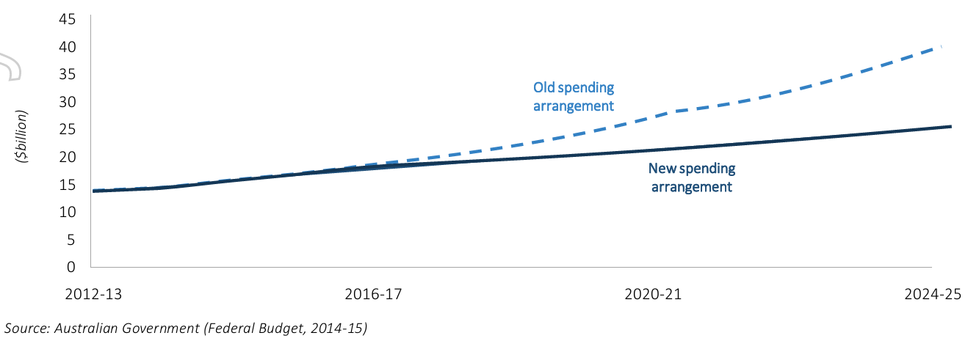
Transition to Community-based Healthcare
Government is shifting the burden of healthcare services from hospital to primary healthcare/allied health via National Healthcare Reform in order to promote healthcare efficiencies by reducing hospital admissions which consume more cost and time.
Federal Government initiative to move the burden of healthcare from hospitals to Primary Care via National Healthcare Reform:
Unfreezing of Medicare indexation ($1bn);
Medication management ($600m);
National Disability Insurance Scheme (NDIS) ($22bn); and
After Hours Care ($145m).
Source: www.health.gov.au & Australian Government , Portfolio budget statements 2017-18 Budget related Paper No. 1.10 Health Portfolio

Slide 13
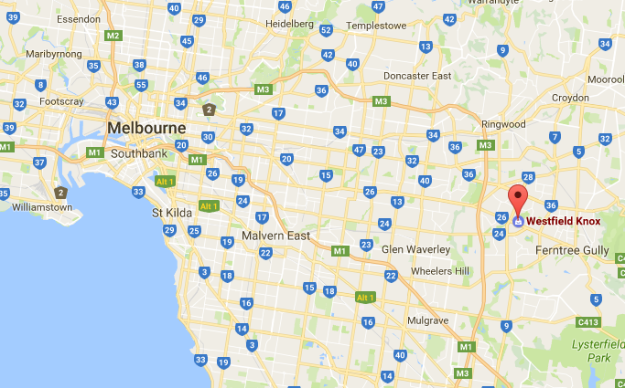
Year acquired | 2013
Purchase price | $2.6m
Est. value | $5.2m (as at Nov 2016)
Background | Pulse Pharmacy Knox was acquired from receivers Located in Westfield Knox Shopping Centre – a super-regional shopping centre located in the outer eastern suburb of Wantirna South, VIC.
Strategy | Rebranded the pharmacy from Pulse Pharmacy to Terry White Chemist Knox Brand new shop-fit installed Restructured management team Introduced new pharmacist services Rebranded medical centre to MedCentral Knox and introduced allied health services Introduced a new multi-function space within the pharmacy for customers to enjoy healthy snacks and drinks (from the Wellness Lab), and attend health and well-being presentations.
Outcome | Pharmacy profitable following restructuring of business Turnover continues to grow y.o.y. Excellent customer service with high customer satisfaction
Case Study – Terry White Chemist Knox

Slide 14
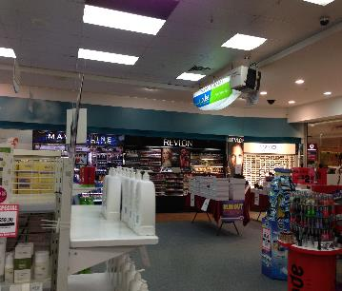
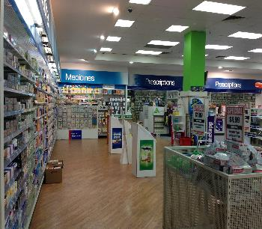
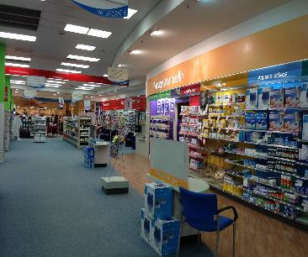
Case Study – Terry White Chemist Knox
Before

Slide 15
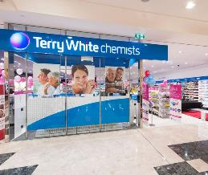
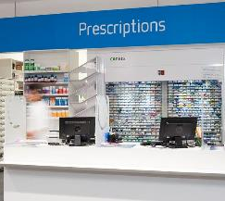
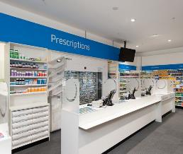
Case Study – Terry White Chemist Knox
After

Slide 16
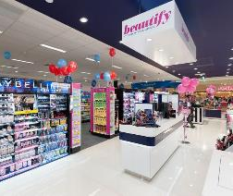
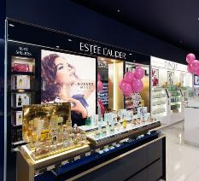
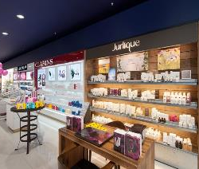
Case Study – Terry White Chemist Knox
After

Slide 17
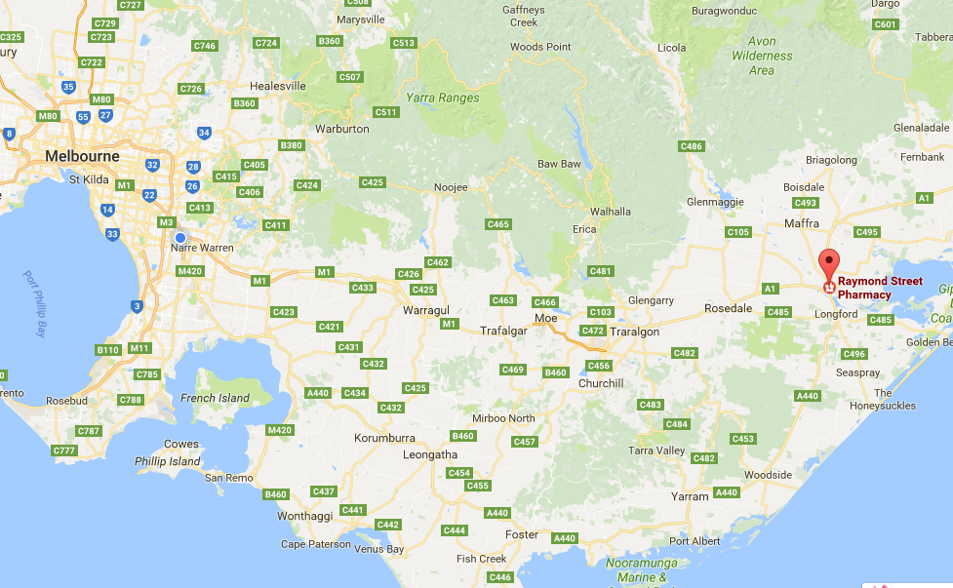
Year acquired | 2012
Purchase price | $1.4m
Est. value | $2.3m (as at 2017)
Background | Pulse Pharmacy Raymond Street Pharmacy was acquired from receivers Located in Sale, situated in Gippsland region of VIC
Strategy | Rebrand the pharmacy from Pulse Pharmacy to Pharmacist Advice Raymond Street Pharmacy Brand new shop fit installed Restructured management team Introduced new pharmacist services
Outcome | Pharmacy profitable following restructuring of business Turnover continues to grow y.o.y. Excellent customer service with high customer satisfaction
Case Study – Pharmacist Advise Raymond Street Pharmacy

Slide 18
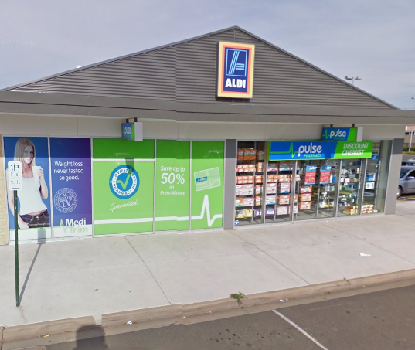
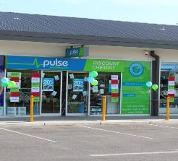
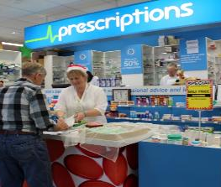
Case Study – Pharmacist Advise Raymond Street Pharmacy
Before

Slide 19
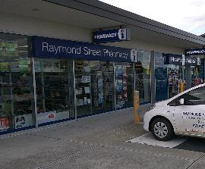
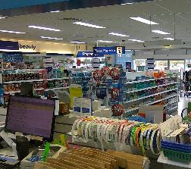
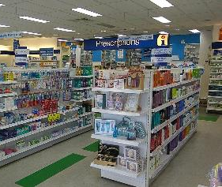
Case Study – Pharmacist Advice Raymond Street Pharmacy
After

Slide 20
Investment Opportunity
Ownership structure
Investor
Autumn Group
Investment facts
Key Facts
Target industry | Healthcare industry including: Primary Care clinics Allied Health clinics Pharmacies Dental clinics
Target return | >15% p.a.
Open date | June 2017
30%
70%
InvestCo
100%
XYZ Co

Slide 21
Example
Investment Opportunity
Investor
Autumn Group
30%
70%
Interest repayments
Management services
$100 Loan
InvestCo
$100
Equity
XYZ Co

